Slide 1
Trading Dashboard
Team: Matthew Willson, Ryan Dibeler, Shishir Suman, Thomas Revelle

Slide 2
Outline
For the project we focused on creating a dashboard that displays stock price, technical indicators, and backtested results for multiple trading strategies
The dashboard displays three momentum trading strategies
Bollinger Bands
Stochastic Oscillator
Relative Strength Index
We tuned the strategies to optimize returns and Sharpe ratios

Slide 3
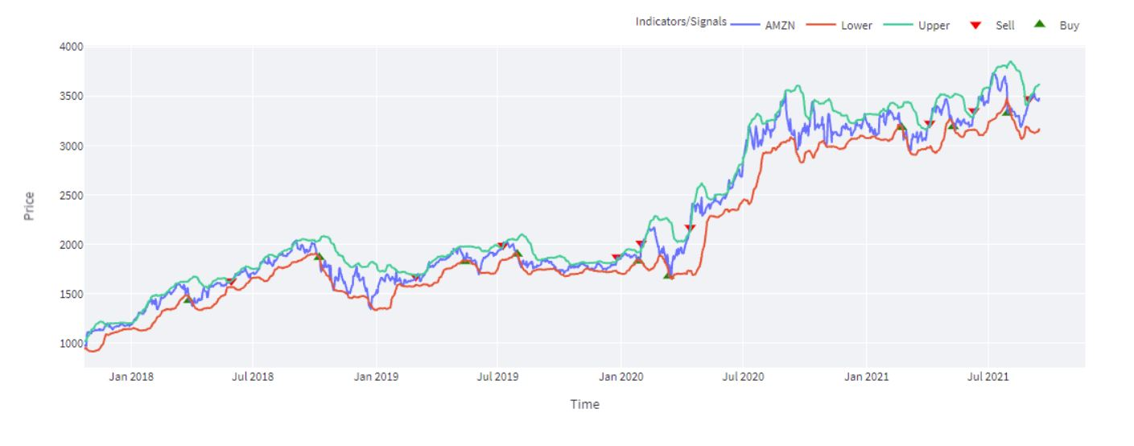
Introduction of Trading Strategies
Momentum strategies are based on technical indicators that reveal when an asset is oversold or overbought

Slide 4
The Momentum Strategies
Differences in our strategies
Bollinger Bands - utilizes the standard deviation of a simple moving average
Developed and copyrighted by John Bollinger in the 1980’s
Stock price is thought to stay within the bands 90% of the time
Relative Strength index - utilizes the average gains and losses in percent change format over over a sample period usually 14 days
Developed in 1978 by J. Welles Wilder Jr in the book “New Concepts in Technical Trading Systems
RSI values above 70 indicate that a security is overvalued, and values below 30 mean that the stock is undervalued
Stochastic Oscillator - utilizes a similar 14 day window to the RSI but it is traded based on actual prices rather than percent change
The Stochastic oscillator was first developed in the 1950’s
It uses a strategy revolving around the moving average

Slide 5
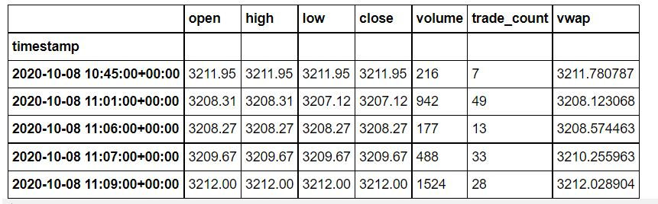
Data
Amazon price data was pulled using the Alpaca Rest API
We ran our algo strategies on Amazon stock for 30 days using minute prices
These prices were stored in a Pandas Dataframe
Then we cleaned up the dataframe to ensure that we were using only closing prices

Slide 6
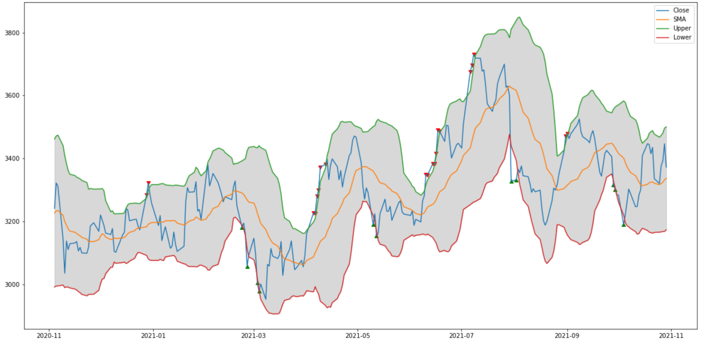
Bollinger Band Crossover Trading Strategy
Bollinger bands are a measure of volatility
SMA +- 2 * rolling std
Theoretically, when the price is below the lower band the asset is oversold and when the price is above the upper band the asset is overbought
Notes:
Bollinger bands are a measure of an asset’s volatility. The bands are traditionally calculated using a 20 day simple moving average of an asset’s price and a 20 day rolling standard deviation of the simple moving average. The area within the bands measures 2 standard deviations from the mean, or a 95% confidence interval for the price. When the price crosses one of the bands, this indicates that an asset is overbought or oversold.

Slide 7
Bollinger Band Crossover Trading Strategy
When the lower band is greater than the price, buy (oversold)
When the upper band is less than the price, sell (overbought)

Slide 8
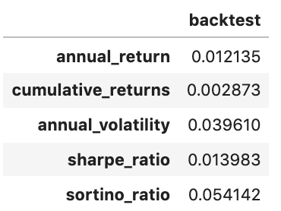
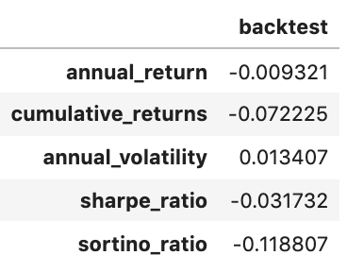
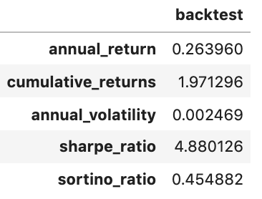
Bollinger Band Backtest methodology
Used the Alpaca API to pull AMZN price from 2016 - 2021
Backtested strategy on different data sets:
Daily Closing Price
Hourly Price
Minute Price
Notes:
I tested the strategy on different time frames as well. In the past year the backtest earned 80%. Amazon had more volatility in the previous 4 years, and over the last year the stock only rose 10%. Based on this, we can infer that the strategy works better on lower volatility stocks. I also tested the algorithm on Tesla, a notorious high volatility stock, the algo performed worse there as well. This is too small of a sample size to assume that the algo works better with low volatility. But if that were the case, a way to improve this strategy would be to implement a parameter that halts trading when the vix is too high or the bollinger band spread is too large.

Slide 9
Bollinger Band Backtest Results
5 Year Performance on Minute Dataset
High Returns
High Sharpe ratio
Low Volatility
Overall good performance
Areas to improve:
Optimize trading frequency
Add additional indicators
Include stop loss

Slide 10
RSI (Relative Strength Index) cont.
Relative Strength Index is one of the most common indicators in technical analysis.
It allows us to have a quick glance as to whether the market is overbought or oversold.
The RSI is calculated using a rather simple way. It is based on the idea of measuring the magnitude of recent price changes.
The RSI bounded between 0 and 100 which makes it easier to interpret in ranging markets.
Traditionally the RSI is considered overbought when above 70 and oversold when below 30.

Slide 11
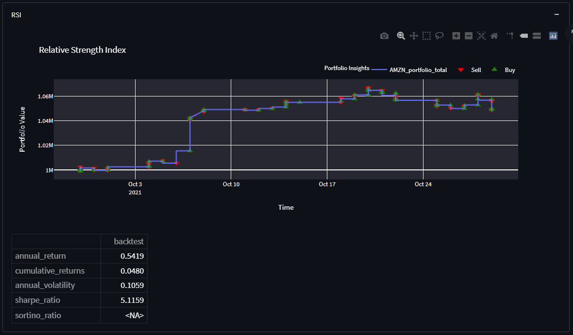
RSI (Relative Strength Index)

Slide 12
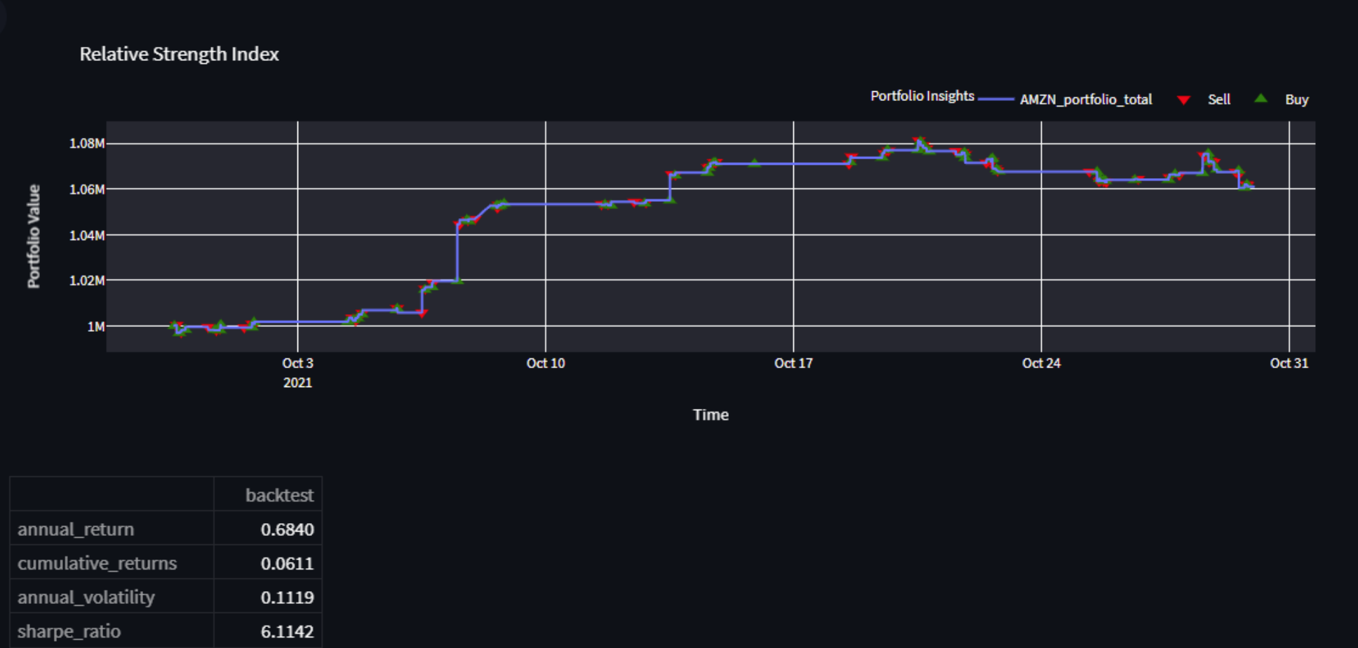
RSI (Relative Strength Index) cont.

Slide 13
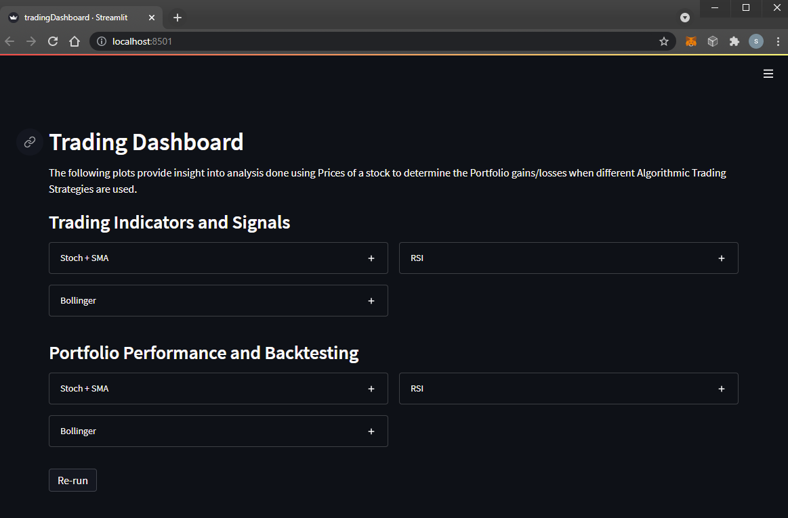
Trading Dashboard
Python Packages used:
Streamlit, Plotly
Deployment via git bash:
streamlit run tradingDashboard.py --theme.base="dark"

Slide 14
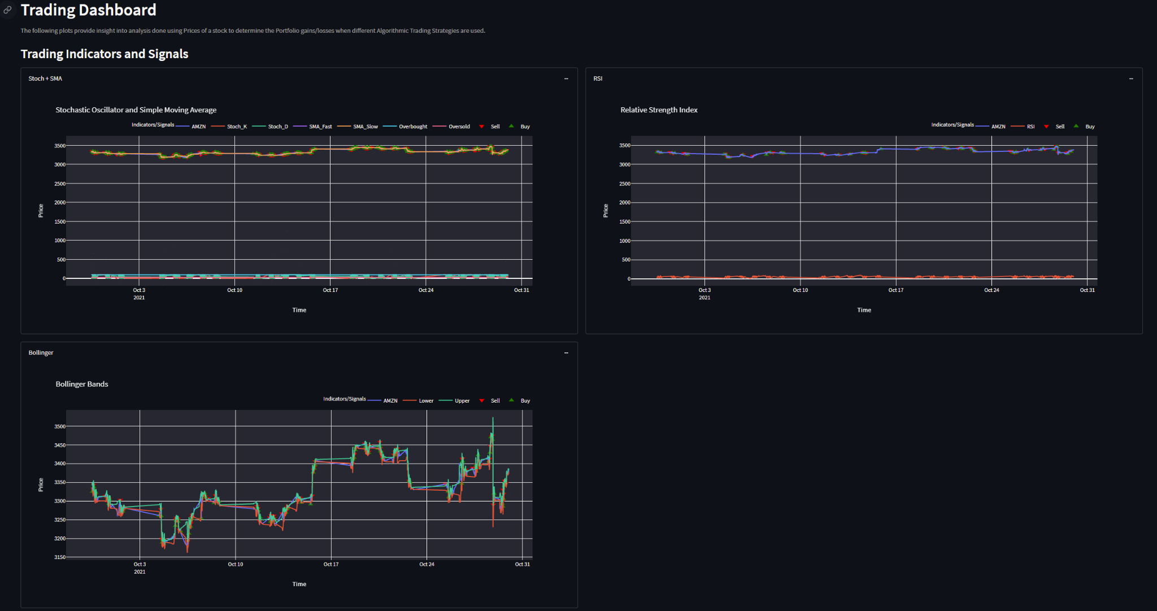

Slide 15
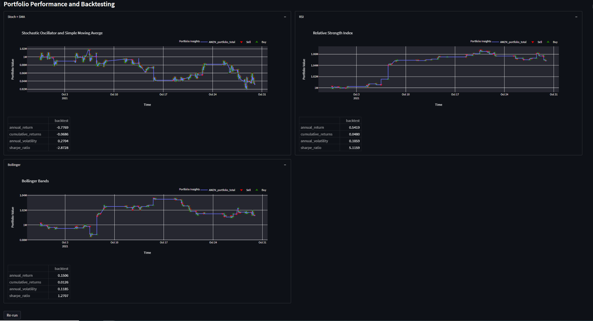

Slide 16
Summary
In conclusion, we found that there is potential to use these strategies in a live trading scenario
Returns and volatility were highly variable based on the timeframe and the frequency of our data
The Stochastic Oscillator had the highest returns and Sharpe ratio over the month period

Slide 17
Future Learning
Optimize trading frequency and indicators
Continue the development of our existing indicators and develop a strategy that uses multiple indicators
In addition to focusing on Amazon, find a way to to trade on multiple stocks simultaneously
Eventually, develop a live trading strategy
Finally, create a dashboard that handles live data streaming
Reinforcement learning and probability trading strategies

Slide 18
Bibliography
https://streamlit.io/
Stochastic Oscillator:
https://medium.com/codex/algorithmic-trading-with-stochastic-oscillator-in-python-7e2bec49b60d
https://www.metastock.com/customer/resources/taaz/?p=106
Sharpe Ratio
https://www.investopedia.com/terms/s/sharperatio.asp
Bollinger Bands
https://www.youtube.com/watch?v=13oogPJwWAM&t=478s&ab_channel=Trading212
RSI
https://www.roelpeters.be/many-ways-to-calculate-the-rsi-in-python-pandas/

